Slide 1
Table of Contents
What is OPC UA and OPC Foundation?
What is Industry 4.0?
What is a PLC, HMI and SCADA?
What was before OPC? Rising of OPC.
Classic OPC – characteristics
OPC UA – next generation OPC and it’s characteristics
Where is used OPC?
What is OEE (Overall Equipment Effectiveness)?
OPC UA Specifications
Compatibility of OPC UA with the older OPC Classic
Communication architectures
Where are we now in OPC UA? Komax projects?

Slide 2
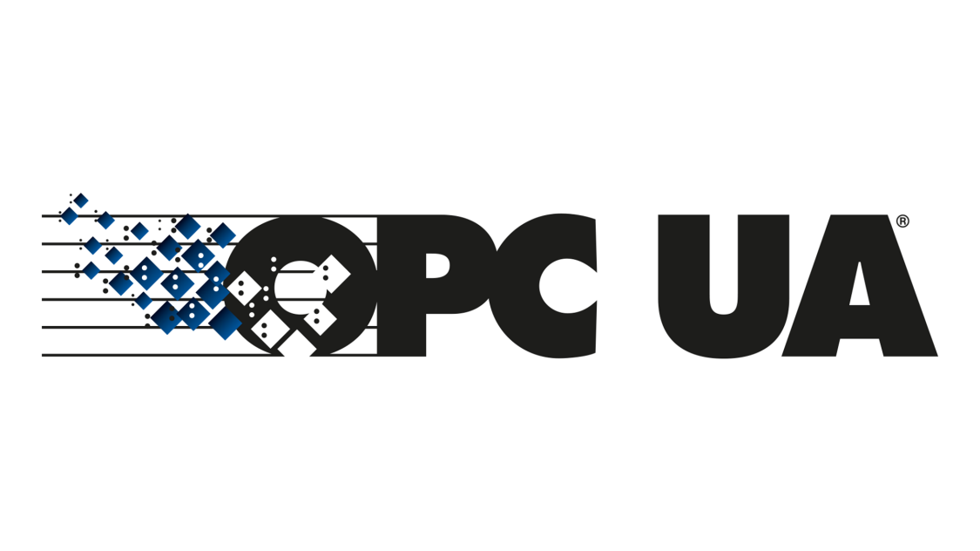
What is an OPC UA?
Open Platform Communications Unified Architecture
OPC UA is a data exchange standard for industrial communication (machine-to-machine or PC-to-machine communication) between different manufacturers.

Slide 3

OPC Foundation
The OPC Foundation is the organization behind the standard and with 678 members it has very broad base.
The foundation mission is ensuring interoperability in automation industry by creating and maintaining open specifications that standardize the communications between multi-vendor systems and production devices.
Its members include global players in the automation industry. For example: Siemens, Honeywell, Microsoft, Beckhoff, SAP, Yokogawa, ABB, Rockwell, Schneider Electric, Wago and others.

Slide 4
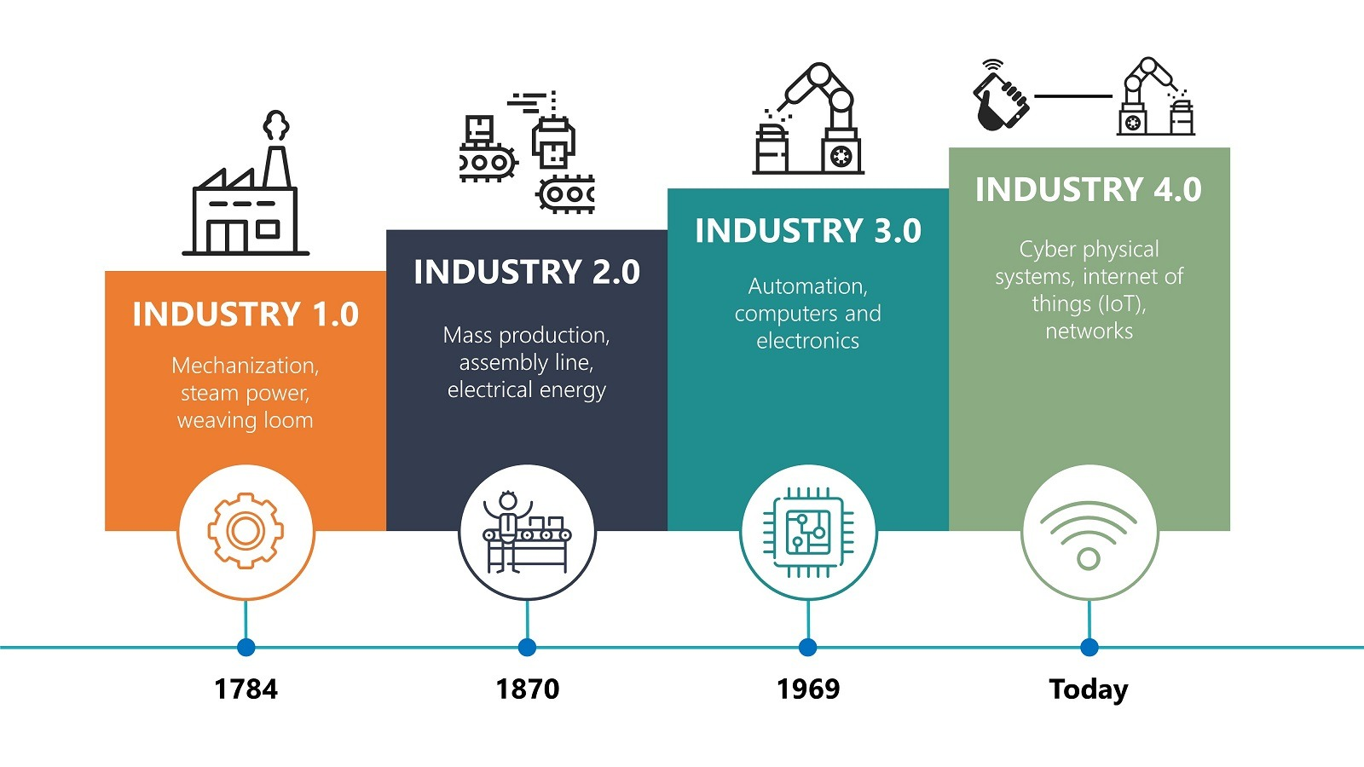
Industry 4.0
Industry 4.0 is the latest evolution of manufacturing.
It refers to the transformation of industry through the intelligent networking of machines and processes with the help of information and communication technology (ICT).
Different kinds of sensors give the opportunity for making of smart factories where every machine action is traced.

Slide 5
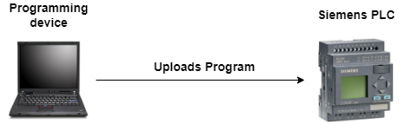
W hat is a PLC?
Programmable Logic Controller (PLC) is simply a special industrial computer that is programmed to control certain processes in industries like petroleum, steel or automotive industry. It contains three main parts: Input Module, CPU and Output Module.
There is also a programming computer, on which is written the program that will execute (and control) on PLC. When the program is written, it has to be uploaded to the PLC.

Slide 6
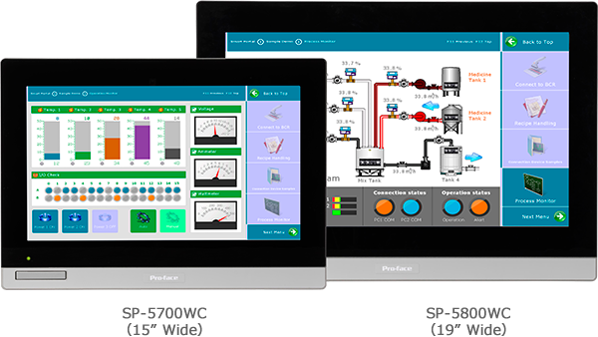
What is an HMI?
A Human-Machine Interface (HMI) is a user interface or dashboard that connects an operator to controller for an industrial system (for example PLC) .
In industrial the HMI is a control system that can be used for: Visual display of data, Track production time, Monitor machine inputs and outputs, oversee KPIs, etc.

Slide 7
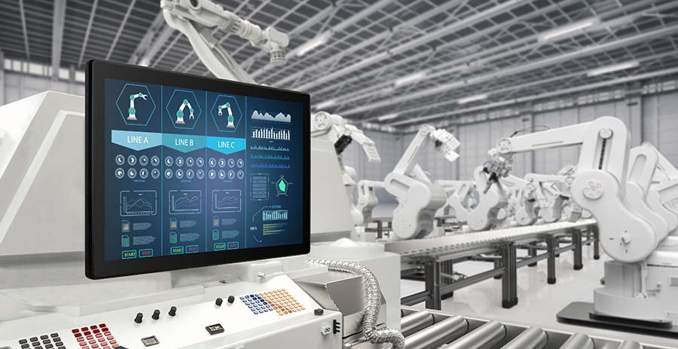
HMI in real environment

Slide 8
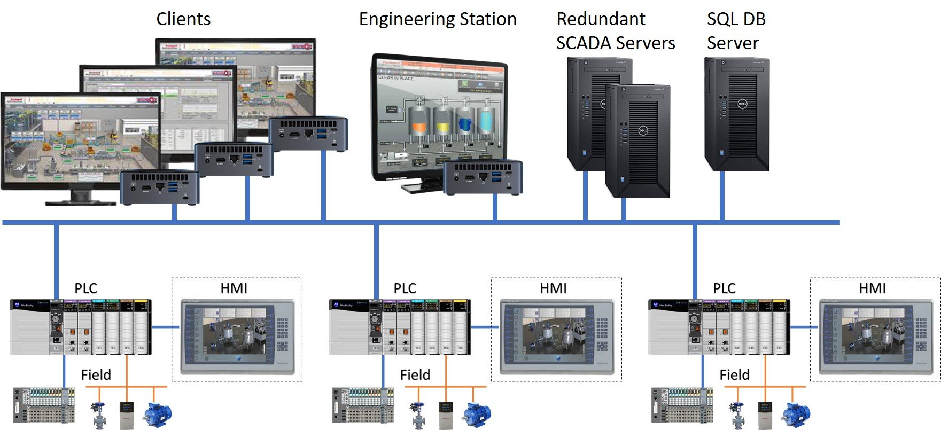
What is a SCADA?
SCADA stands from “Supervisory control and data acquisition” is a control system comprising computers, networked data communications and graphical user interface for high-level supervision of machines and processes. It also covers sensors and other devices, such a PLCs.
The main goal of this supervisory systems is to monitor and control equipment in the industrial processes for companies in the public and private sectors.

Slide 9
SCADA vs HMI
In general SCADA systems are used to control and monitor large areas, e.g. entire production plant in real time.
HMIs are linked to a controller and are installed very close to the machines.
In addition, SCADA systems combine many systems such as sensors, PLCs and others. The data collected by all these systems is sent to the central SCADA unit, which will have its own HMI.
In conclusion, the HMI can be part of the SCADA, but the SCADA cannot be part of an HMI.

Slide 10
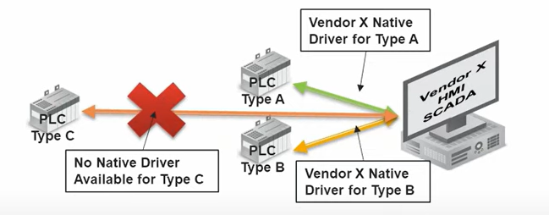
Before OPC
Before OPC there is no standard for communication between industrial control devices (e.g. PLC), and computer applications (HMI and others), which are designed to use real-time data, from these controllers.
Proprietary drivers were developed by each HMI/SCADA vendor. This limited the customer choices, to only the hardware for which software drivers had been written.

Slide 11
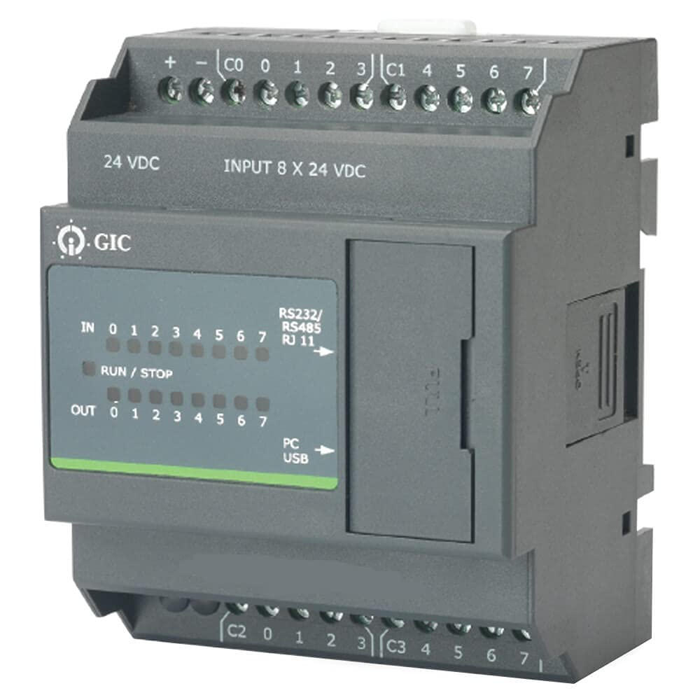
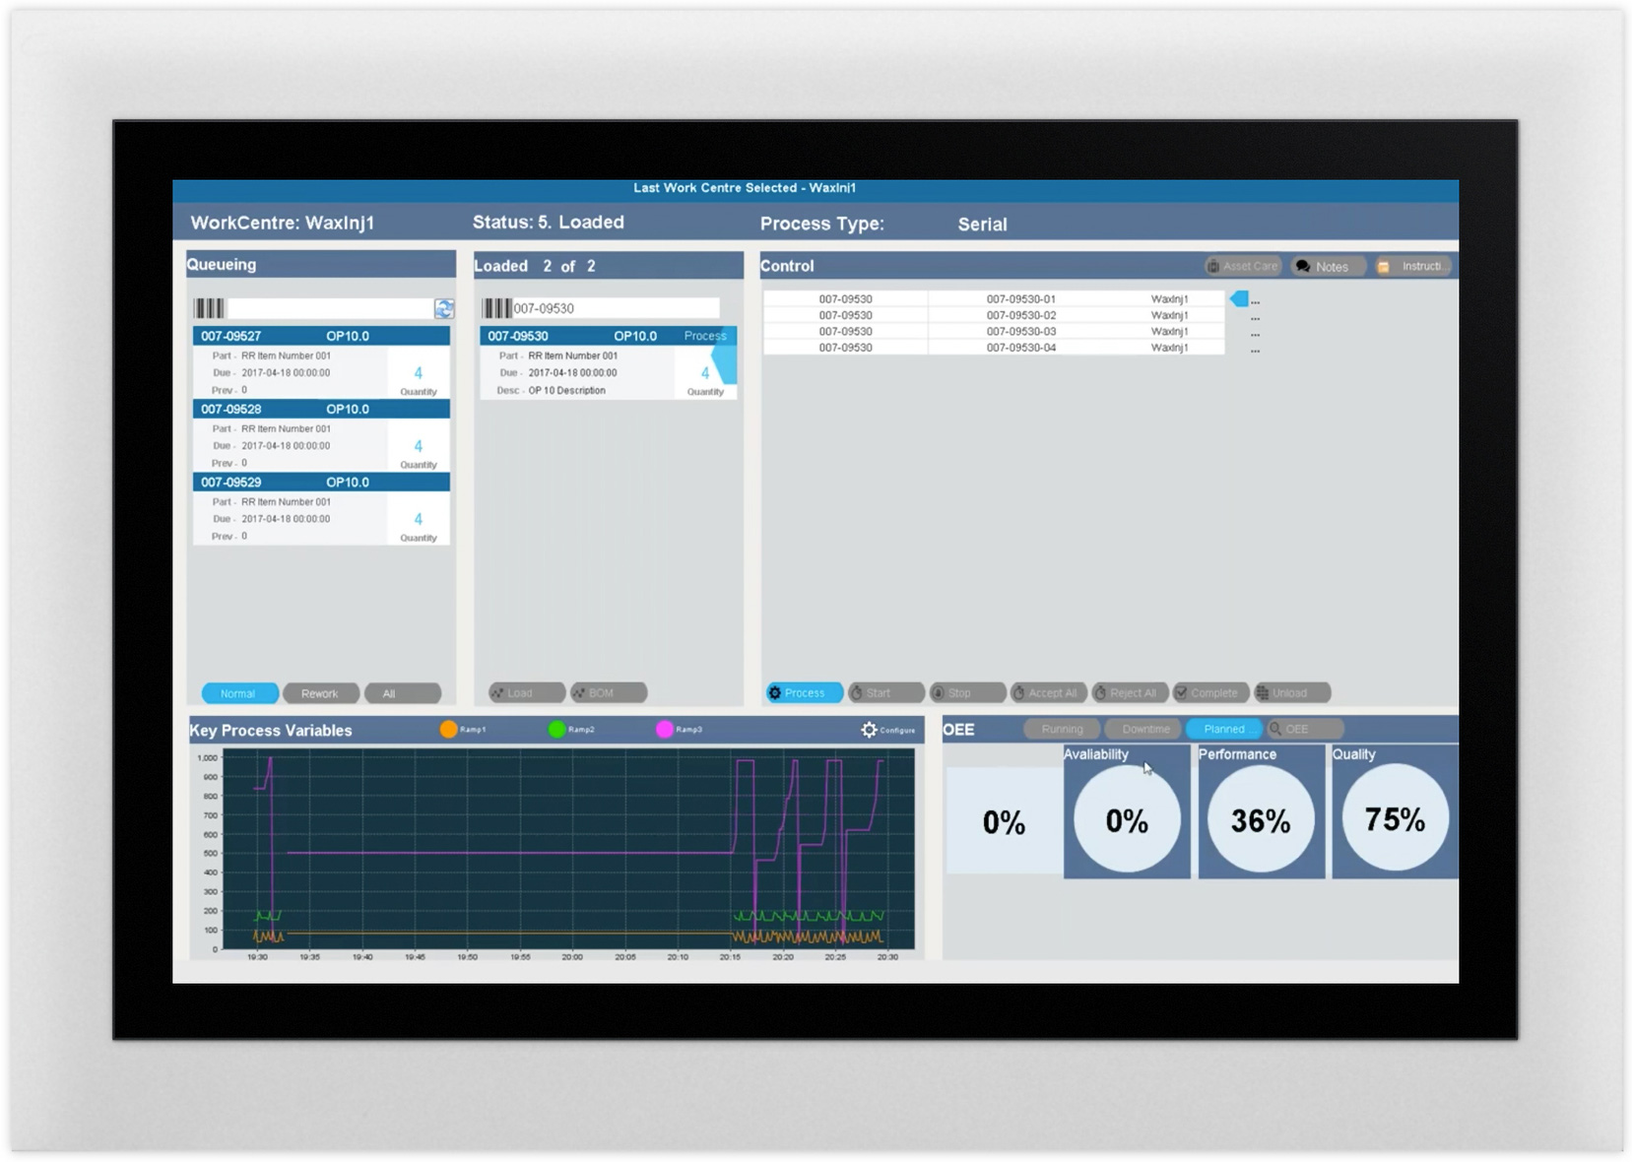
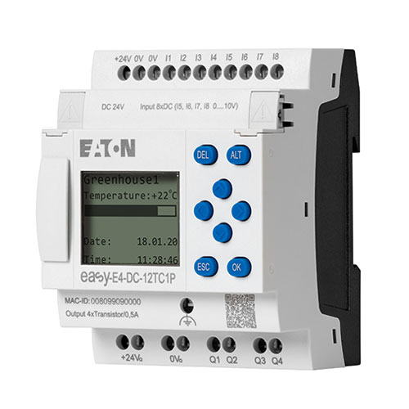
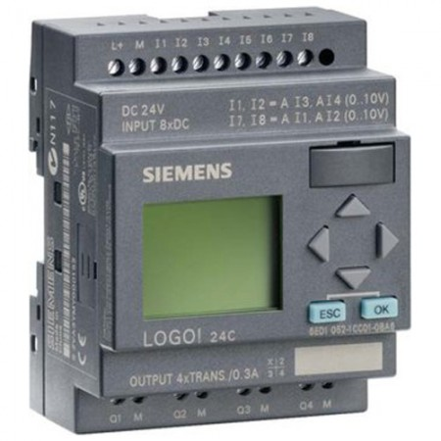
What was before OPC? Driver diversity problem!
GIC PLC
GIC driver
EATON driver
Siemens driver
EATON PLC
HMI system
Siemens PLC

Slide 12

Classic OPC
GIC PLC
Windows PC
OPC Server
COM/DCOM
EATON PLC
HMI system (OPC client)
Siemens PLC

Slide 13

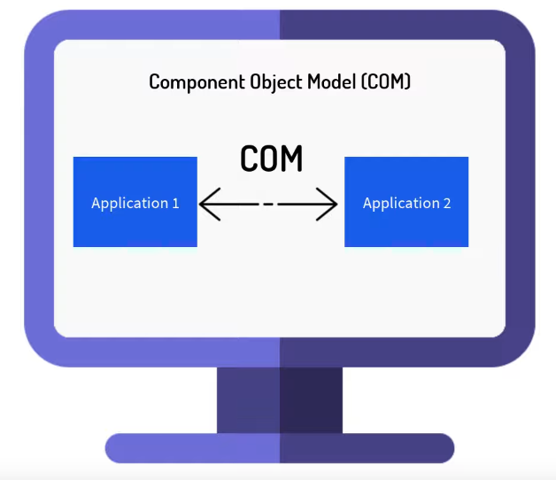
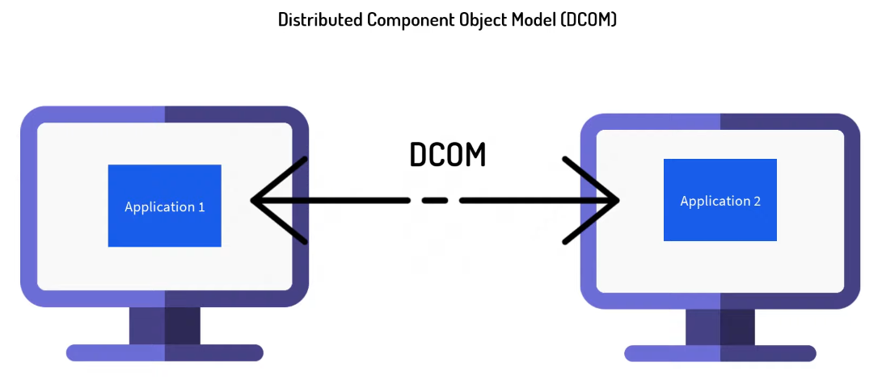
Classic OPC
The communication is based on COM and DCOM which are Microsoft technologies.
It works only on Windows machines and has not so rich features like OPC UA.
OPC is a software interface standard that allows Windows programs to communicate with industrial hardware devices.

Slide 14

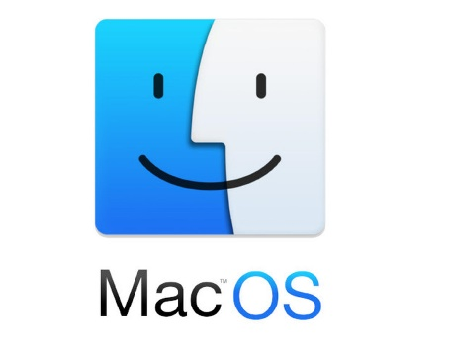

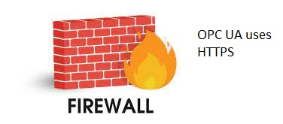
OPC UA
Platform Independence
OPC UA first release is in 2008.
It has many more features than the old OPC.
It is platform independent and not only for Windows.
It has built in security and is Internet friendly oriented (No Firewall problems).
It is designed for work in Internet and specially for Industry 4.0.
It relies on TCP/IP protocol stack and uses Https and OPC binary protocol.
OPC UA
Firewall friend

Slide 15
OPC UA
GIC PLC
OPC Server
Eaton PLC
HMI system (OPC client)
Siemens PLC

Slide 16

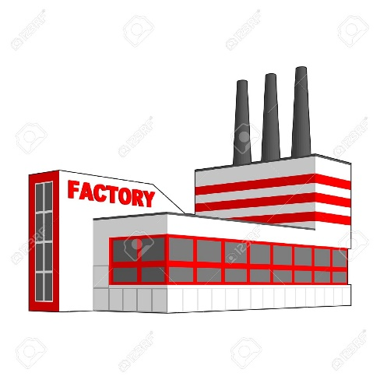


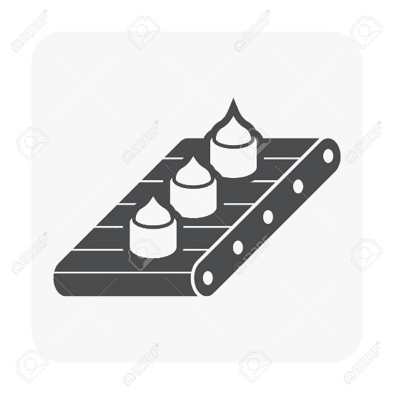
Where is used OPC UA?
OPC UA

Slide 17
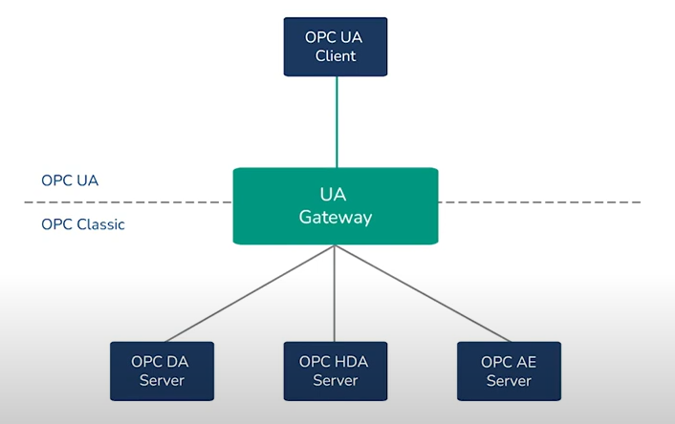
Compatibility with OPC Classic via gateway/s

Slide 18
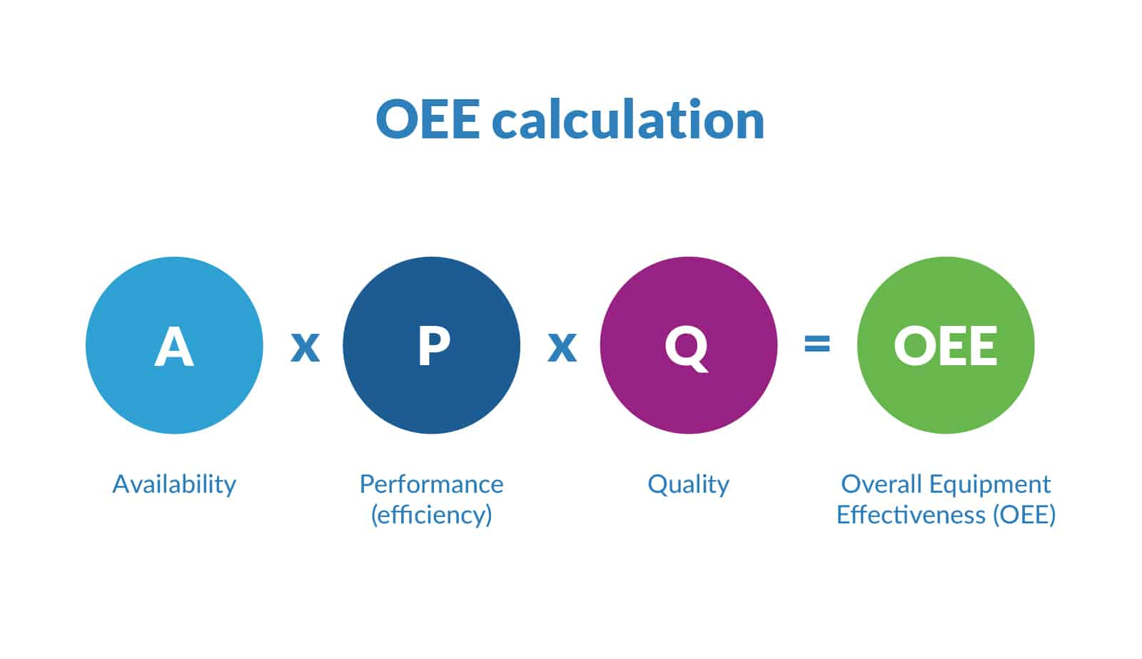
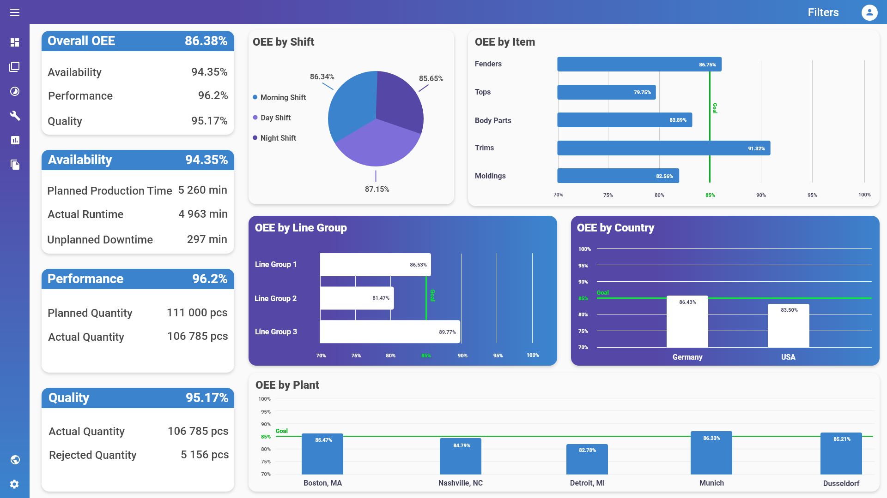
OEE (Overall Equipment Effectiveness)
It’s a gold standard for measuring manufacturing productivity.
By measuring of OEE and the underlying losses, we can get important insights on how to systematically improve our manufacturing process.

Slide 19
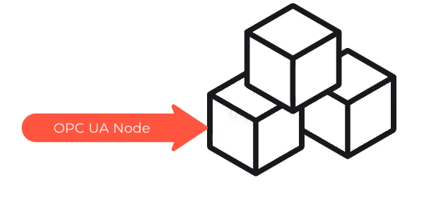

OPC UA Specifications
Information model
Communication architectures
Security
Historical access
Alarms and Events
Programs
"ns=2;s=/FloorOne/Machines/Pump"

Slide 20

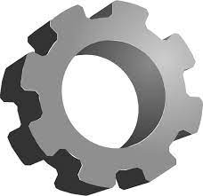
Communication architectures
Pub/Sub model (notifications)
Client/Server model (session)
client
client
server
server
client
session
client
client

Slide 21
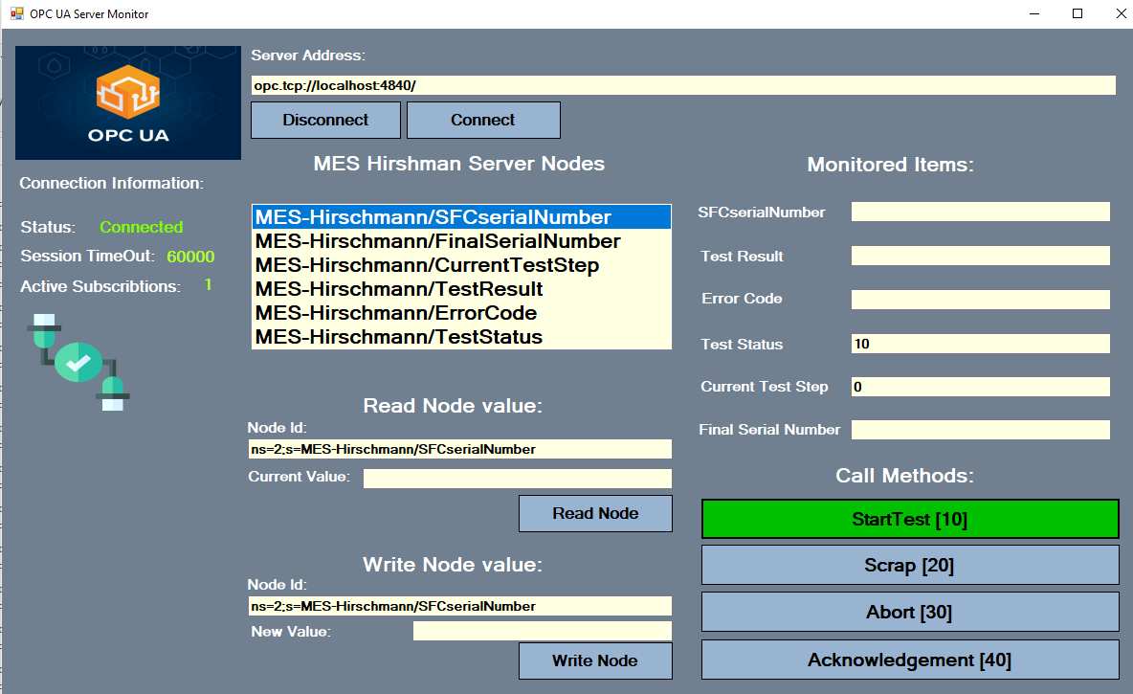

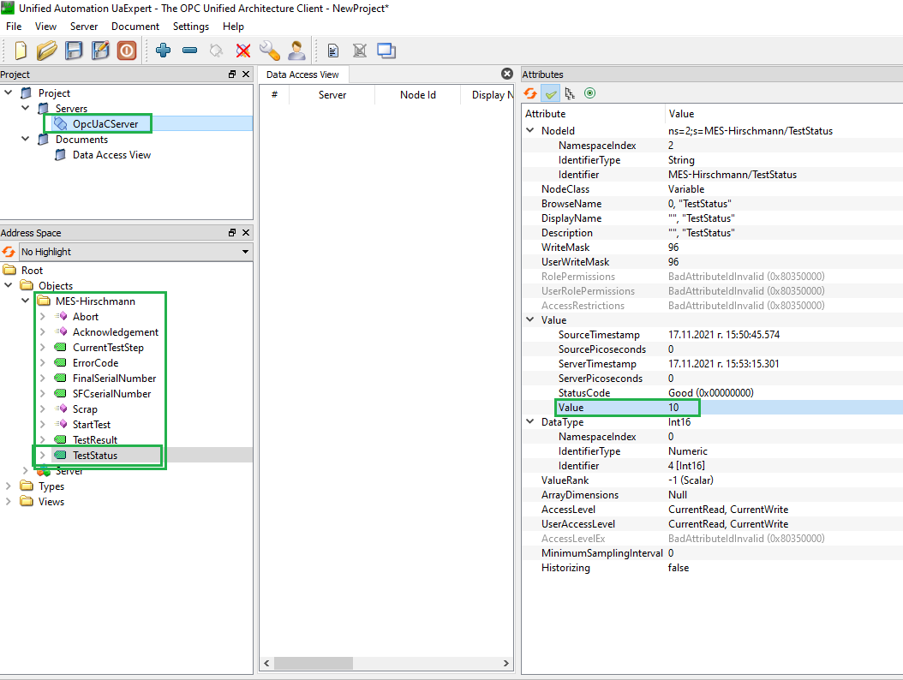
Hirschman project
client
read
server
write
read
publisher
client
write
subscriber

Slide 22
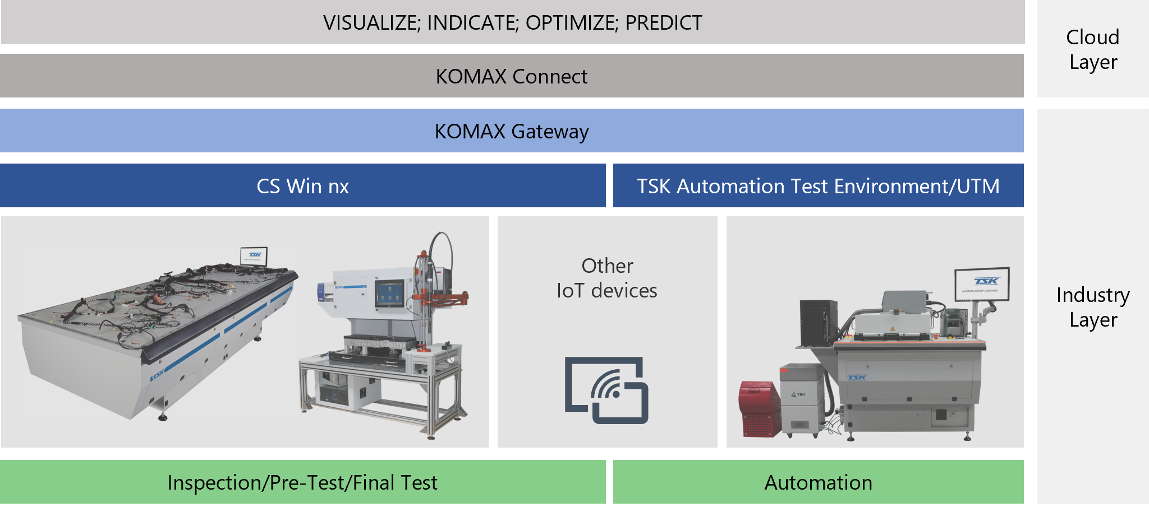
Komax Connect Project
We already have an initial connection between CS WIN and the cloud KOMAX system.
For this purpose was developed CS WIN COM object which serves as a OPC UA client and OPC UA server which is a Windows service app that running on the same PC.

Slide 23


KOMAX Connect Project
CS WIN
(OPC UA client
– COM object)
KOMAX Gateway
OPC UA server (Win service)
Cloud dashboard
write data
read data
OPC UA
OPC UA

Slide 24
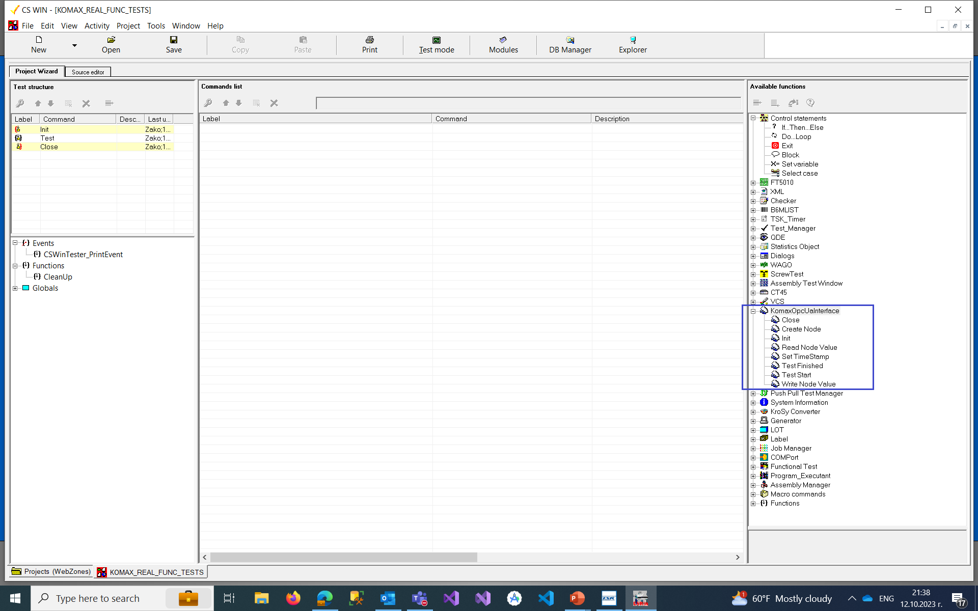
View from Komax Connect client in CS WIN

Slide 25
OPC UA in summary
OPC UA is a data exchange standard for industrial communications between machines or between machines and computers (computer systems).
The standard OPC UA is successor of OPC Classic, and it is released in 2008 by OPC Foundation
It is platform independent - runs on Windows, Linux, Android, MacOS
Relies on TCP/IP protocol stack and HTTPS protocol
The OPC UA is with Client/Server architecture
It is ready for Internet (No Firewall problems)
Has compatibility with OPC Classic
Komax is a member of OPC Foundation

